Slide 1

CHRONO-PULSE AI
AI-Powered Sleep Disorder Prediction System
Live Demo →

Slide 2

Sleep Disorders: A Global and Costly Health Crisis
1
1 in 3 adults do not get enough quality sleep
2
Sleep disorders often go undiagnosed for years, leading to serious health issues
3
Medical sleep studies cost $1,000–$3,000 and are inaccessible to many
4
Long waiting lists for specialist appointments delay diagnosis
5
People ignore warning signs until health problems develop

Slide 3

CHRONO-PULSE AI: Free, Instant, and Accessible Screening
An easy-to-use web application that analyzes your lifestyle data and predicts potential sleep disorders before they become serious health issues.
✓
Provides preliminary screening to bridge the gap between initial concern and formal diagnosis
✓
No cost, no sign-up, and accessible from any device
✓
Instant results with personalized, actionable recommendations

Slide 4
Goal 1: Building the Predictive Model
Build a machine learning model that accurately predicts three sleep conditions with high accuracy and reliability.
1
2
3
No Sleep Disorder
Insomnia
Sleep Apnea
Healthy sleep pattern with no significant issues
Difficulty falling or staying asleep
Breathing interruptions during sleep

Slide 5
Goal 2 & 3: User Experience and Accessibility
Goal 2: User-Friendly Interface
Goal 3: Universal Accessibility
1
Enter health and lifestyle information easily
1
No cost to use (free for everyone)
2
Get instant predictions about sleep health
2
Works on any device (responsive web app)
3
Receive personalized, actionable recommendations
3
No medical knowledge required to use the tool

Slide 6

Supervised Learning: Training AI on Real-World Sleep Data
Our Approach
We used supervised machine learning, training our system on real data from 374 people with professionally evaluated sleep health. This approach allows the model to learn patterns from actual cases and make accurate predictions.
The Data We Analyze (Input Features)
Personal Information
Sleep Patterns
Age
Sleep duration
Gender
Sleep quality
Occupation
Stress levels
BMI
Physical Activity
Health Vitals
Exercise minutes
Heart rate
Daily steps
Blood pressure

Slide 7
Gradient Boosting: The Winning Model for Prediction
Models Tested
Why Gradient Boosting Won
Logistic Regression (baseline)
1
Highest accuracy: 96% compared to other models
K-Nearest Neighbors
2
Best at handling multiple features and complex relationships in data
3
Most reliable predictions for our dataset size (374 samples)
Support Vector Machine
Random Forest
96%
Gradient Boosting ← Selected
Overall Accuracy
Neural Network

Slide 8
System Flow: From User Input to Personalized Advice
User's Browser
Machine Learning Model
↓
↓
React Frontend (Vercel)
Prediction Result
↓
↓
REST API Calls
→
Personalized Recommendations
↓
↓
FastAPI Backend (Render)
Back to User
Each component works together seamlessly to deliver instant, personalized sleep health predictions directly to your browser.

Slide 9
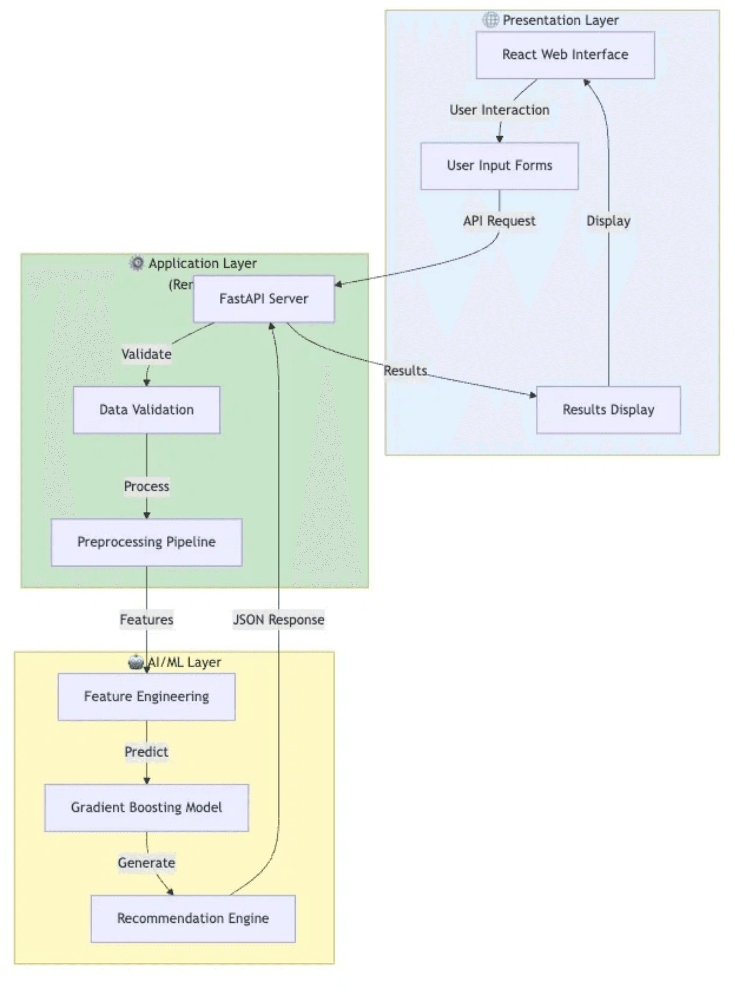

Three-Tier Architecture
Presentation Layer
React Web Interface & User Input Forms
Application Layer
FastAPI Server, Validation & Preprocessing
AI/ML Layer
Feature Engineering & Prediction Model

Slide 10
Technology Stack: Modern, Scalable, and Free Hosting
Frontend
Backend
Machine Learning
1
React.js
1
Python FastAPI
1
Scikit-learn
Modern user interface framework
High-performance API framework
ML library for model training
2
Responsive Design
2
Gradient Boosting
2
374 Health Records
Works on all devices and screen sizes
ML model for predictions
Real-world training data
3
Real-Time Updates
3
Data Pipeline
3
23 Input Features
Health score updates as you type
Preprocessing and feature engineering
Comprehensive health parameters
4
Vercel Hosting
4
Render Hosting
4
3 Output Classes
Free, fast, and reliable deployment
Free cloud deployment platform
Sleep condition predictions

Slide 11
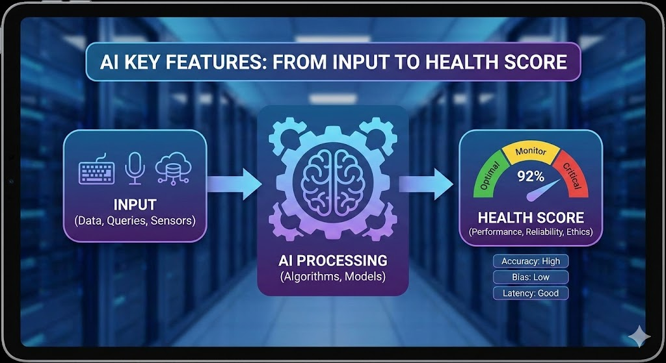
Key Features: Input and Health Score
1. Easy Data Input
•
Simple form with sliders and dropdowns
•
No medical terminology needed
•
Takes just 5 minutes to complete
2. Real-Time Health Score
•
Score updates as you fill the form
•
Ranges from 0-100 for easy understanding
•
Visual circular indicator for immediate feedback

Slide 12

Key Features: Prediction and Recommendations
3
AI-Powered Predictions
4
Personalized Recommendations
Get results in seconds
Specific advice based on your data
Shows confidence levels for each possibility
Actionable tips you can start today
Color-coded for easy understanding
Focus on lifestyle improvements

Slide 13
Key Feature 5: Privacy and No Data Storage
🔒
Complete Privacy Protection
Your health information is never stored on our servers. Every prediction is processed and immediately forgotten.
1
No Data Storage
Your information is not saved on our servers after analysis
2
Complete Privacy
No tracking, no profiling, no sharing with third parties
3
No Sign-Up Required
Use the tool instantly without creating an account or providing personal details

Slide 14
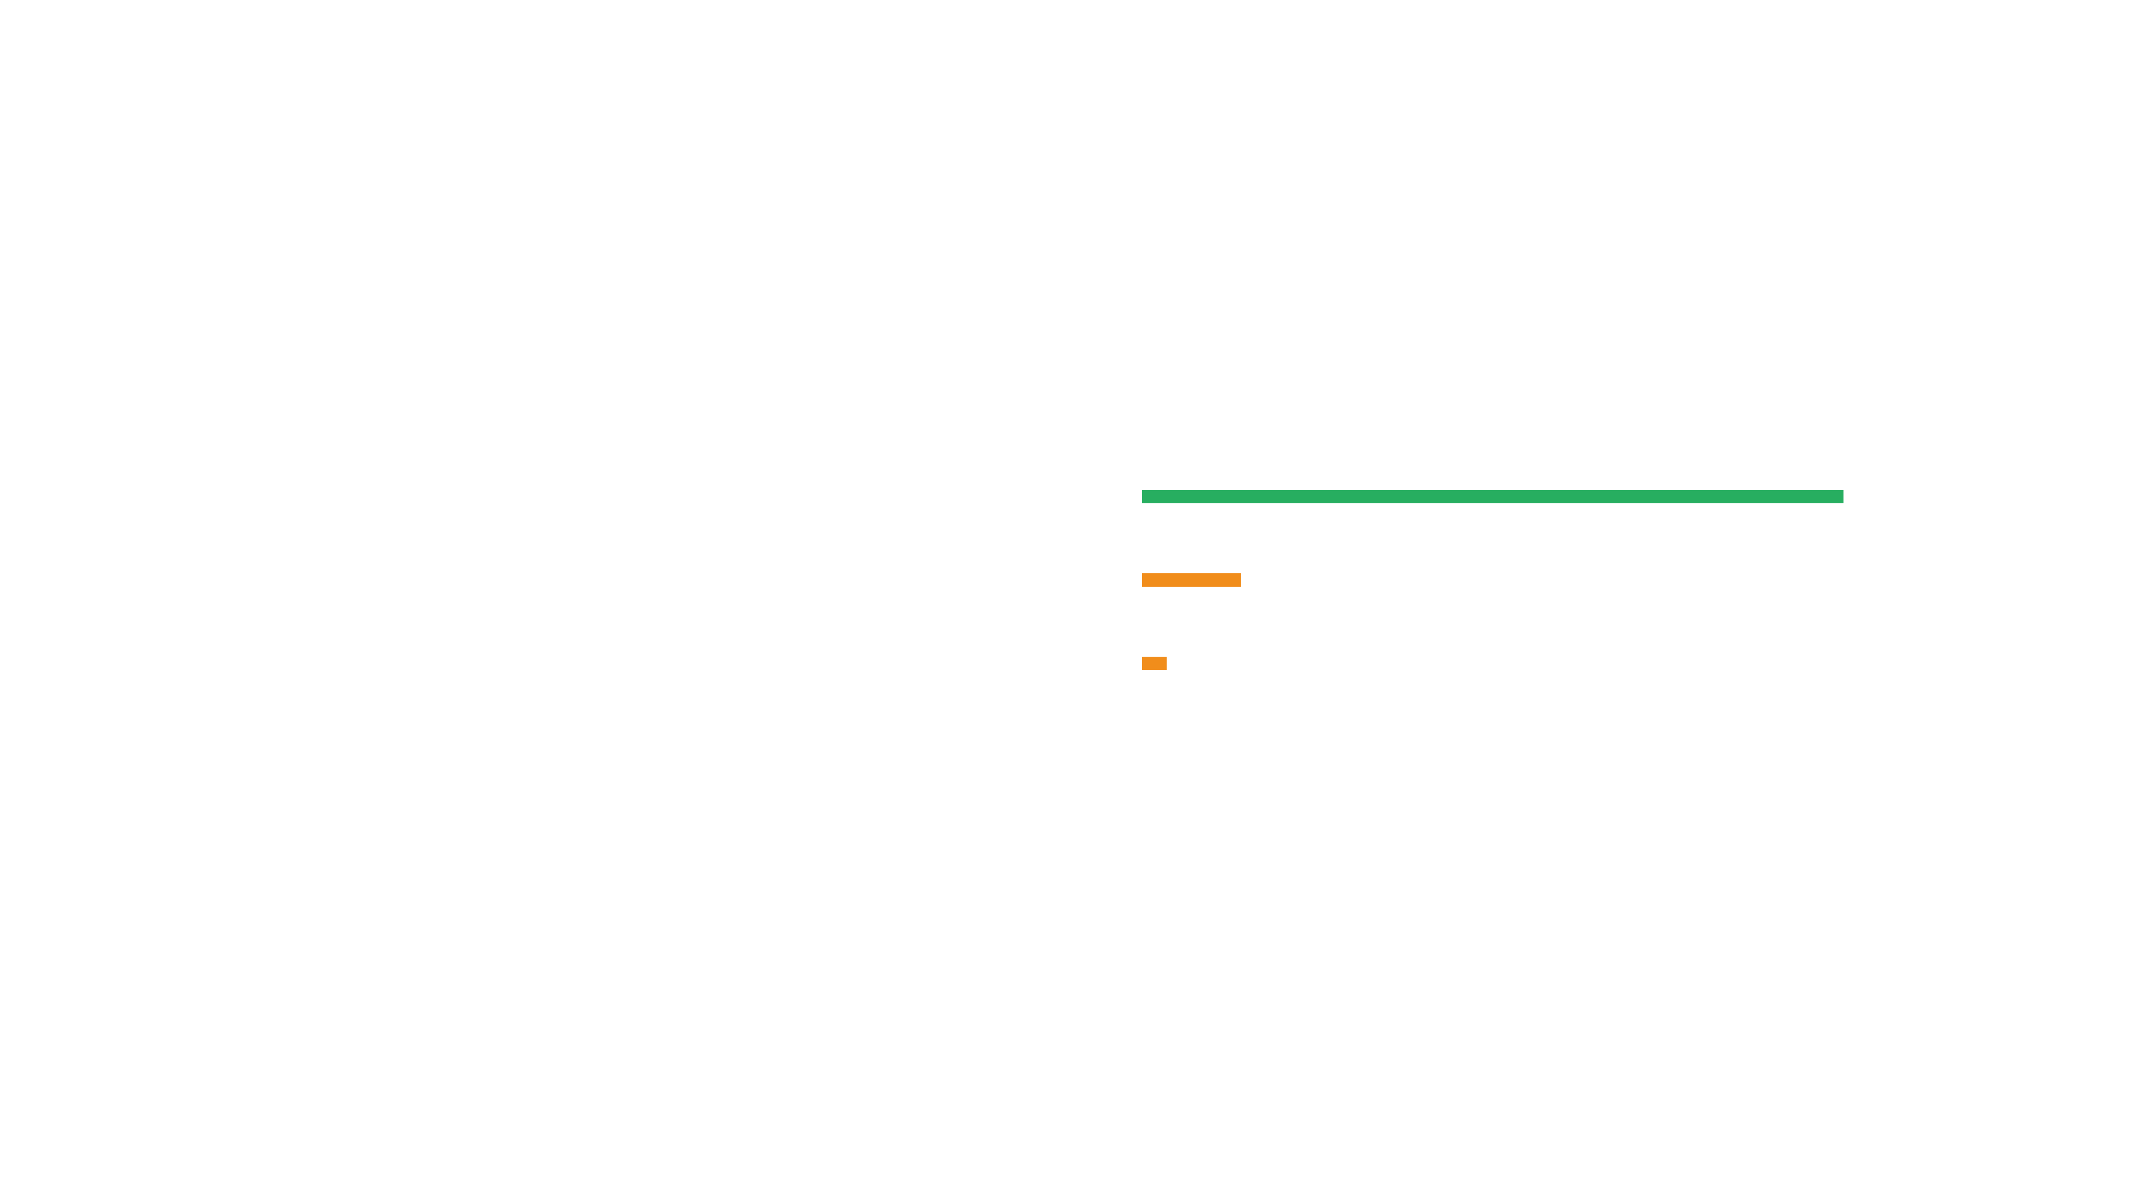
Live Demo: Input and Results
Input Screen
Results Screen
Personal Information
Sleep Health Prediction
Age: 28 years
No Sleep Disorder
85%
Gender: Male
BMI: 24.5
Insomnia
12%
Sleep Apnea
3%
Sleep Patterns
Sleep Duration: 7 hours
Sleep Quality: Good
Stress Level: Moderate
Large, clear result card with confidence percentages and color-coded progress bars. Green indicates healthy, yellow indicates caution, and red indicates concern.
Physical Activity
78
Exercise Minutes: 45 min/day
Daily Steps: 8,000
Health Score
Clean, organized interface with four sections for easy data entry. Real-time health score updates as you fill the form.

Slide 15
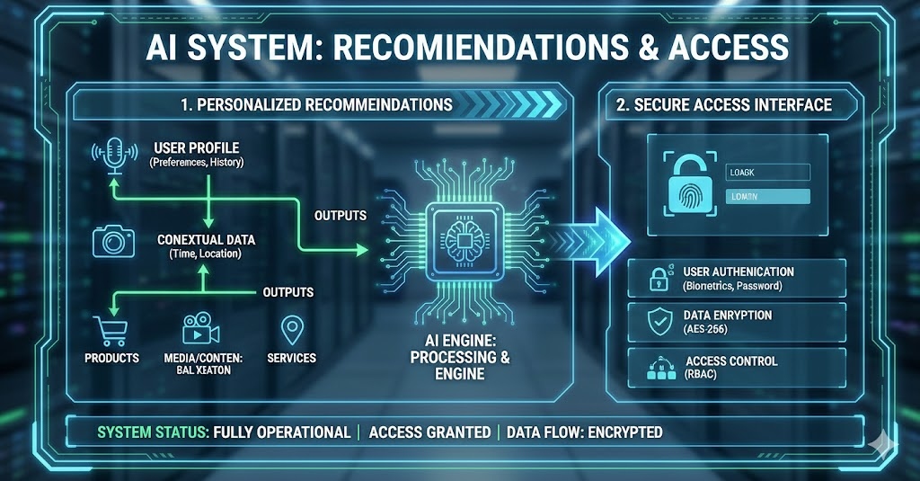
Live Demo: Recommendations and Access
Personalized Recommendations
1
Numbered list of specific actions tailored to your health data
Try It Yourself!
2
Based on individual health metrics and sleep patterns
3
Easy to understand and follow recommendations
https://chronopulse-frontend.vercel.app
4
Focus on preventive care and lifestyle improvements
First prediction may take 30-60 seconds as the system wakes up. This is normal for free hosting!
How to Use:
1
Open the link in any browser
2
Fill in the health assessment form
3
Click "Analyze Sleep Health"
4
Wait for results
5
Read your personalized recommendations

Slide 16

Model Performance: 96% Accuracy for Reliable Screening
96%
Overall Accuracy
Precision
Recall
F1-Score
96.06%
96.00%
95.99%
What This Means
Out of 100 predictions, 96 are correct — demonstrating high reliability
Very few false alarms — users can trust the results
Reliable enough for screening purposes — can effectively identify potential issues

Slide 17
Performance Breakdown and Validation
Performance by Class
Validation Methodology
No Sleep Disorder
1
Used 5-fold cross-validation to ensure robust results
100%
2
Tested on separate data not seen during training
Insomnia
3
Consistent results across different data splits
93%
4
Confirms model reliability for real-world predictions
Sleep Apnea
88%

Slide 18
Challenge 1 & 2: Overcoming Data Limitations
1
Limited Dataset Size
2
Imbalanced Classes
The Issue
The Issue
Only 374 samples available for training the model
More "No disorder" cases than other sleep conditions in the dataset
The Risk
The Risk
Overfitting — model memorizes data instead of learning generalizable patterns
Model could be biased toward predicting the majority class, missing actual disorders
Our Solution
Our Solution
Used simpler models and implemented rigorous cross-validation to ensure the model generalizes well to new data
Analyzed each class separately and optimized performance metrics for each sleep condition independently

Slide 19
Challenges Faced: Deployment and Engineering
Challenge 3
Challenge 4
Challenge 5
Deployment Complexity
Model Compatibility
Feature Engineering
The Issue
The Issue
The Issue
Free hosting has limitations. Backend sleeps when not in use, causing delays.
Python version conflicts and library version mismatches during deployment.
Raw data needed transformation: blood pressure split into two fields, categorical variables encoded.
Our Solution
Our Solution
Chose reliable free platforms (Render + Vercel) and managed user expectations with clear messaging about cold start times.
Locked specific versions in the requirements.txt file to ensure consistency across all environments.
Our Solution
Developed a careful preprocessing pipeline to handle all data transformations automatically.

Slide 20
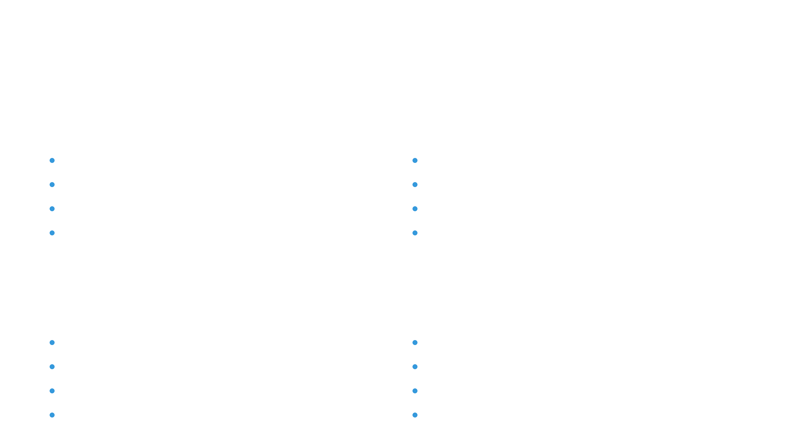
What We Learned: Technical Skills
🤖
Machine Learning
🔧
Full-Stack Development
Real-world ML implementation with supervised learning
Frontend development with React.js
Model selection and performance evaluation
Backend development with Python FastAPI
Data preprocessing and feature engineering
Responsive and user-centered design
Cross-validation and model validation techniques
Integrating ML models into web applications
🌐
API Design & Deployment
☁️
Cloud Hosting Platforms
RESTful API design and implementation
Deployment on Vercel for frontend
API documentation and testing
Deployment on Render for backend
Frontend-backend communication
Environment configuration and management
Error handling and data validation
Free tier optimization and scaling

Slide 21
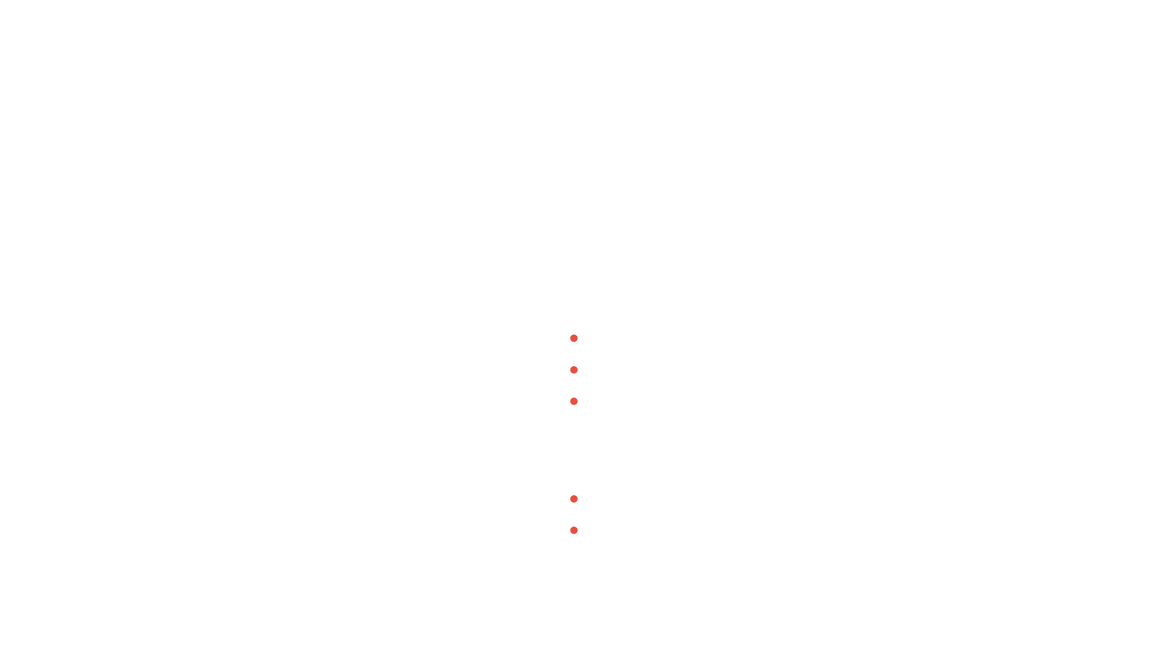

Important Limitations: Not a Diagnostic Tool
Not a Medical Diagnosis
This is a screening tool only, not a replacement for professional medical evaluation
Cannot replace a doctor's evaluation or clinical diagnosis
Should not be used to make treatment decisions without professional consultation
Dataset Limitations
Trained on only 374 cases — may not represent all populations
Performance might vary for different demographic groups and populations

Slide 22

Limitations: User Input and Hosting
1
Self-Reported Data
2
Free Hosting Constraints
Relies on user input accuracy — users must enter their own health information
First prediction takes 30-60 seconds — system needs time to wake up from sleep mode
No way to verify information — we cannot independently confirm the data provided
Backend sleeps after inactivity — free hosting automatically suspends unused services to save resources
Results depend on honest answers — inaccurate or incomplete data leads to less reliable predictions
Not instant for cold starts — subsequent predictions are much faster after the initial load
Impact
Workaround
For best results, users should provide accurate and complete information about their sleep and health habits.
This is a normal limitation of free hosting. For production use, paid hosting would provide instant responses without delays.

Slide 23

Future Improvements: Data and Features
1
Bigger Dataset
2
Advanced Features
Collect data from thousands of people to improve model accuracy
Integration with fitness trackers (Apple Watch, Fitbit, etc.)
Include more diverse populations to ensure fairness across demographics
Historical tracking over time to monitor sleep health trends
Progress monitoring dashboard with visual analytics and insights
Add more sleep disorder types beyond the current three categories
Export reports as PDF for sharing with healthcare providers

Slide 24

Future Improvements: AI and Clinical Validation
🧠
Better AI Models
📱
Enhanced UX
🏥
Clinical Validation
Try deep learning approaches for improved accuracy
Build a mobile app version for iOS and Android
Partner with sleep clinics for validation
Add multi-language support for global reach
Compare predictions with actual diagnoses
Ensemble multiple models for robust predictions
Implement voice input option for accessibility
Publish research results in medical journals
Implement real-time learning from user feedback
Improve accessibility features for all users
Get medical professional endorsement
Continuous model optimization and retraining

Slide 25

Project Impact: Users and Healthcare System
👤
Individual Users
🏥
Healthcare System
Early awareness of potential sleep issues before they become serious
Reduce unnecessary appointments by pre-screening patients
Motivation to improve lifestyle and sleep habits
Identify high-risk individuals for targeted interventions
Free preliminary screening accessible to everyone
Lower healthcare costs through early detection and prevention
Educational value about sleep health and risk factors
Better resource allocation for specialist care

Slide 26

Project Impact: Professionals and Society
💼
Wellness Professionals
🌍
Society
Data-driven client consultations based on objective health metrics
Raise awareness about the importance of sleep health
Track client progress over time with consistent assessment tools
Make screening accessible to everyone regardless of location or income
Objective health assessment to complement subjective observations
Reduce stigma around sleep problems and mental health
Conversation starter about sleep health with clients and patients
Promote preventive healthcare and early intervention

Slide 27
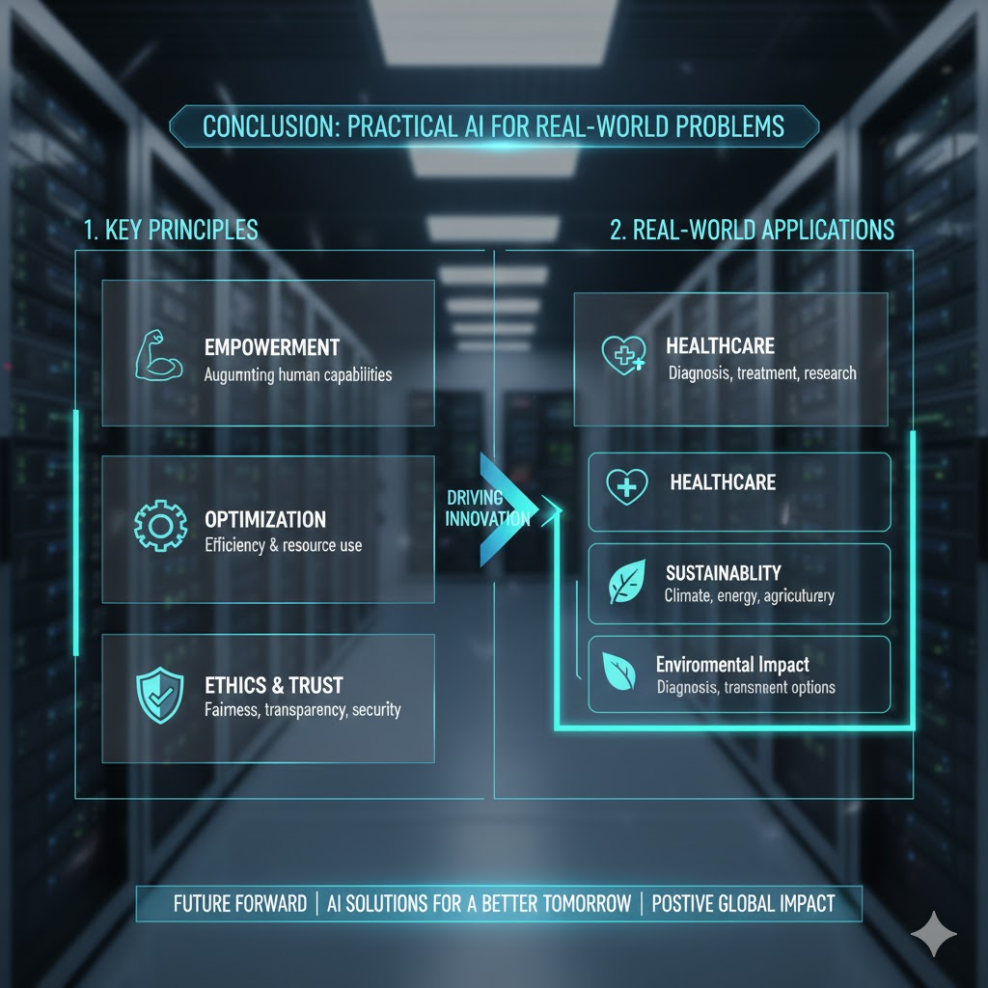
Conclusion: Practical AI for Real-World Problems
What We Accomplished
✓
Built a working AI system that predicts sleep disorders with 96% accuracy
✓
Created an easy-to-use web application accessible to anyone, anywhere
✓
Deployed on free platforms that will run indefinitely without ongoing costs
✓
Provided a tool that could help people become more aware of their sleep health
✓
Learned valuable skills in AI, web development, and teamwork
Key Takeaway
Artificial intelligence doesn't have to be complicated or expensive to make a real difference in people's lives. Our project shows that with the right approach, even students can build practical AI solutions to important health problems.

Slide 28
Thank You
For your attention and interest in CHRONO-PULSE AI
Questions?
We'd love to hear your thoughts, feedback, and questions about the project. Feel free to ask!
Try the Live Demo
https://chronopulse-frontend.vercel.app
Visit the link above to experience the application firsthand

